Slide 1
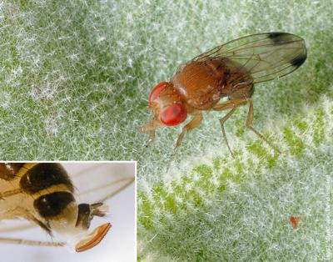
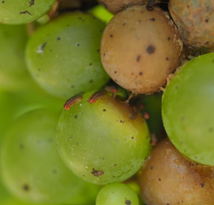
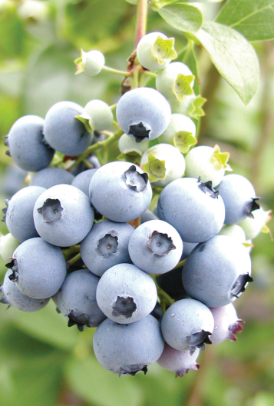
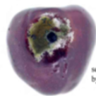
Role of yeast in attractive sugar bait lures for Drosophila suzukii, Spotted wing Drosophila (SWD)
Notes:
Cause severe damages in berries: Raspberry, strawberry, grapes
SWD Laying egg in ripening fruits still on plants (serrated/saw like ovipositor) V/S to D-Mels lay eggs overripe, fermenting on the ground.
Larve feed and pupae inside the fruits
Full life cycle of 8-10 days: Multivoline
Increase spread of microbes (rot-sour grapes).
Secondary damage by mould and other microbes

Slide 2
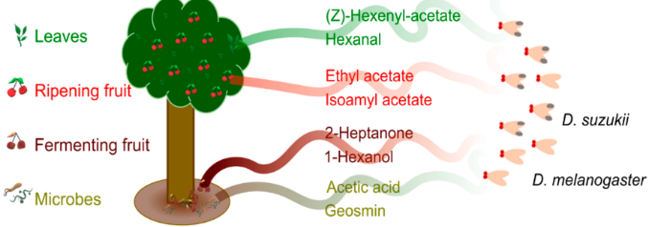
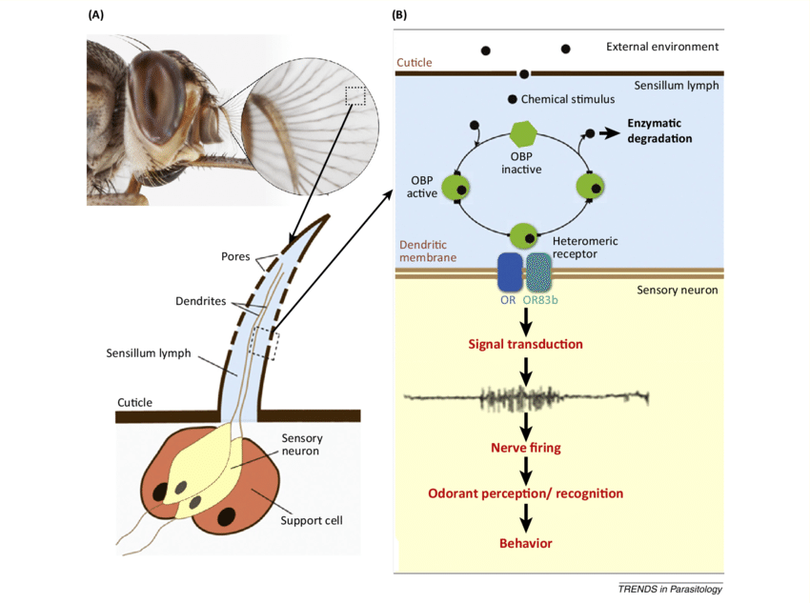
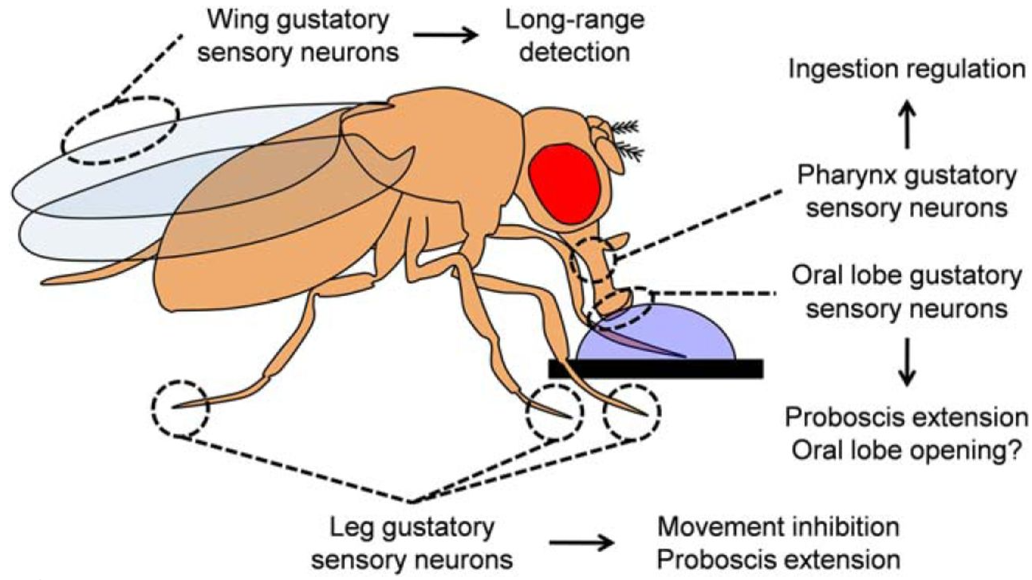
Insect feeding cues
"How do insects choose their food sources?"
(i) Insects rely on olfactory cues (volatile odors) to locate food, reproduction (sex pheromone)
Antennal lobe: olfactory receptors, process chemical signal
Dumeni et al., 2025
(ii) Gustatory receptor neurons (GRNs)
Masiga et al., 2014
Vladimiros et al., 2017
Notes:
Cues are detected by receptors in the antennae of insects
Pheromone are important cues for egg laying in females,
male specific pheromone cis-vaccenyl acetate (cVA) implicated as the key aggregation pheromone that attracts both males and females (gather in groups to feed/breed)
Enzymatic degradation leads to signal transduction
Odorant-degrading enzymes (ODEs) - act in signal inactivation
Odorant-binding proteins (OBPs) - contribute to the sensitivity of the olfactory system by transporting odorants through the sensillar lymph

Slide 3
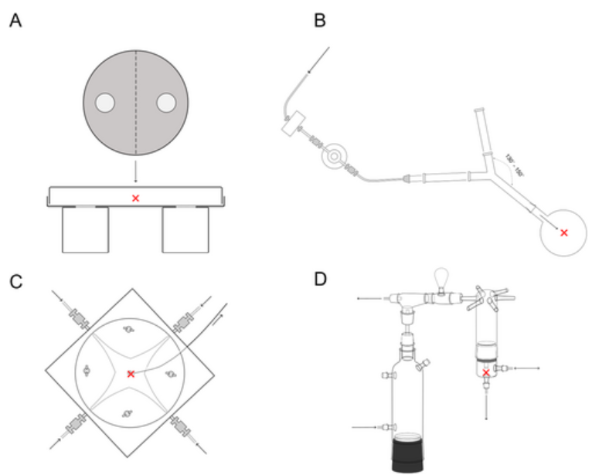
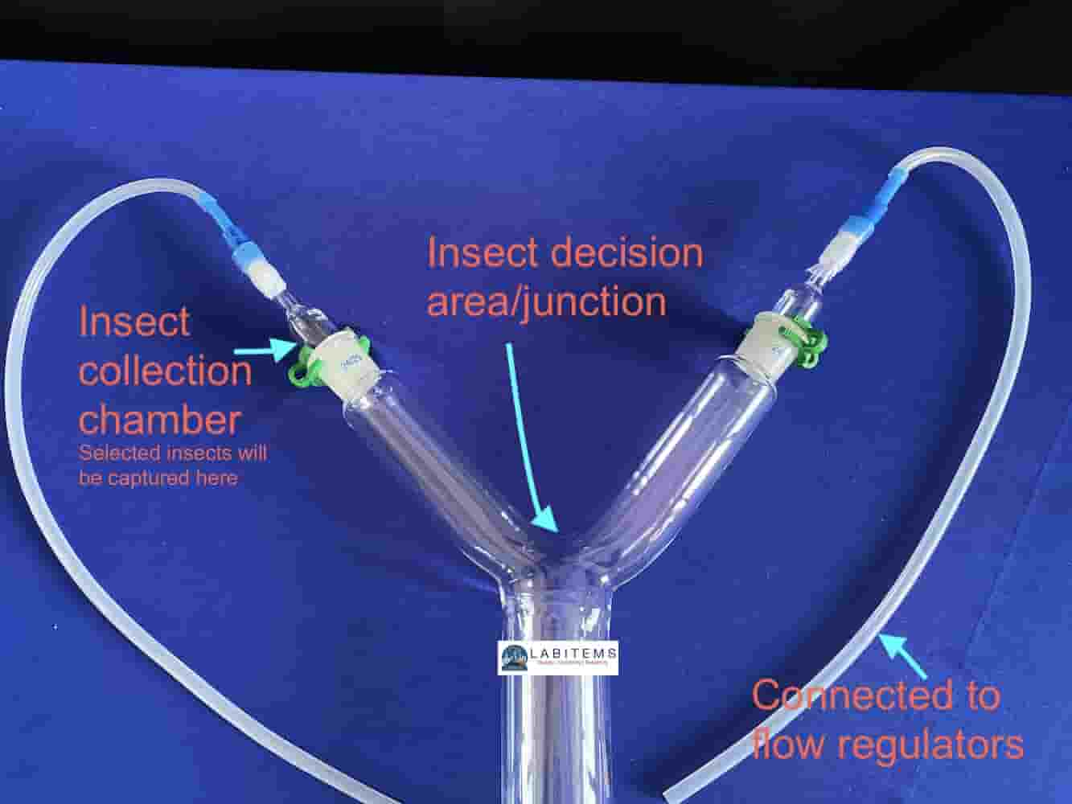
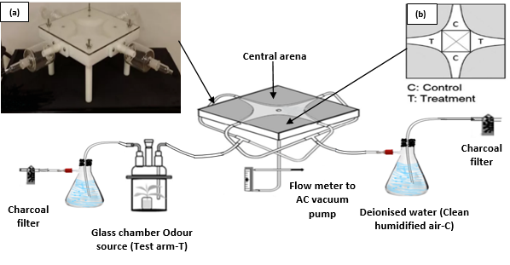
Olfactometers in entomology and chemical ecology
Study insect olfactory behavioral responses to various odor sources.
Still air olfactometer (Weeks et al., 2011)
Y-tube (two-arm) olfactometer (Roberts et al., 2019)
2-way olfactometer (Y-tube)
4-way olfactometer
Four-arm olfactometer (Vet et al., 1983)
Upright six-arm olfactometer (Turlings et al., 2004)
Assess insect preferences for certain odors
Study of pheromones, Volatiles, repellents, and attractants

Slide 4
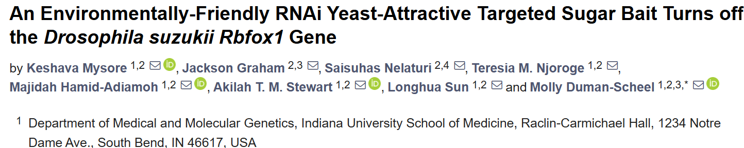
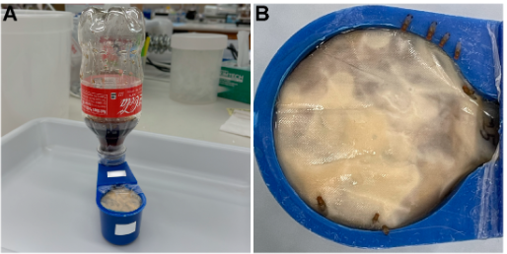
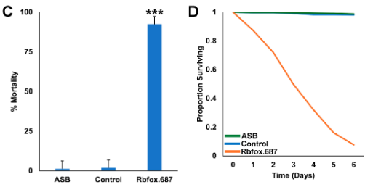
Insect olfaction/chemosensory in SWD monitoring and IPM
Monitoring presence, activity and population density.
Attractive baits (Attract, trap-kill control ).
SWD feeds on ‘yeast-laden’ fruits and is attracted to fermentation products: Apple Cider Vinegar (ACV) or wine/vinegar mixture.
Need for species specificity: most catches include other Drosophila spp and non-target insects.
RNA interference (RNAi) pesticides developed as a novel pest management strategy (dsRNA target genes).
RNAi yeast formulations selectively target SWD without affecting beneficial insects (Rbfox.687).
Flies died over a 6-day period
Notes:
RNAi pesticides work by silencing essential genes in target organisms, disrupting vital biological functions and leading to mortality.
Double-stranded RNAs (dsRNAs) delivered via microinjection, ingestion, or soaking
Significant mortality was observed in D. suzukii that drank from a soda bottle ATSB feeder prepared with Coca-Cola^{R} and Rbfox.687 yeast (*** p < 0.001 vs. flies that fed on soda alone or soda prepared with control yeast, ANOVA).

Slide 5
Aim
Evaluate the efficacy of sugar bait lures combined with yeast in attracting SWD for infestation monitoring and RNAi yeast feeding in the field and laboratory.
Objective
Determine the attractiveness of SWD sugar bait lures both in the field and laboratory.
Evaluate the effect of yeast on sugar bait attractiveness to SWD.
Notes:
Cuveatte: This work did not involve RNAi work, Prof. Molly Duman Scheel: Indiana University,
RNA interference (RNAi) pesticide that specifically targets an SWD gene, to lure and
kill flies that feed on the yeast which will be delivered as a component of an attractive
targeted sugar bait (ATSB).

Slide 6
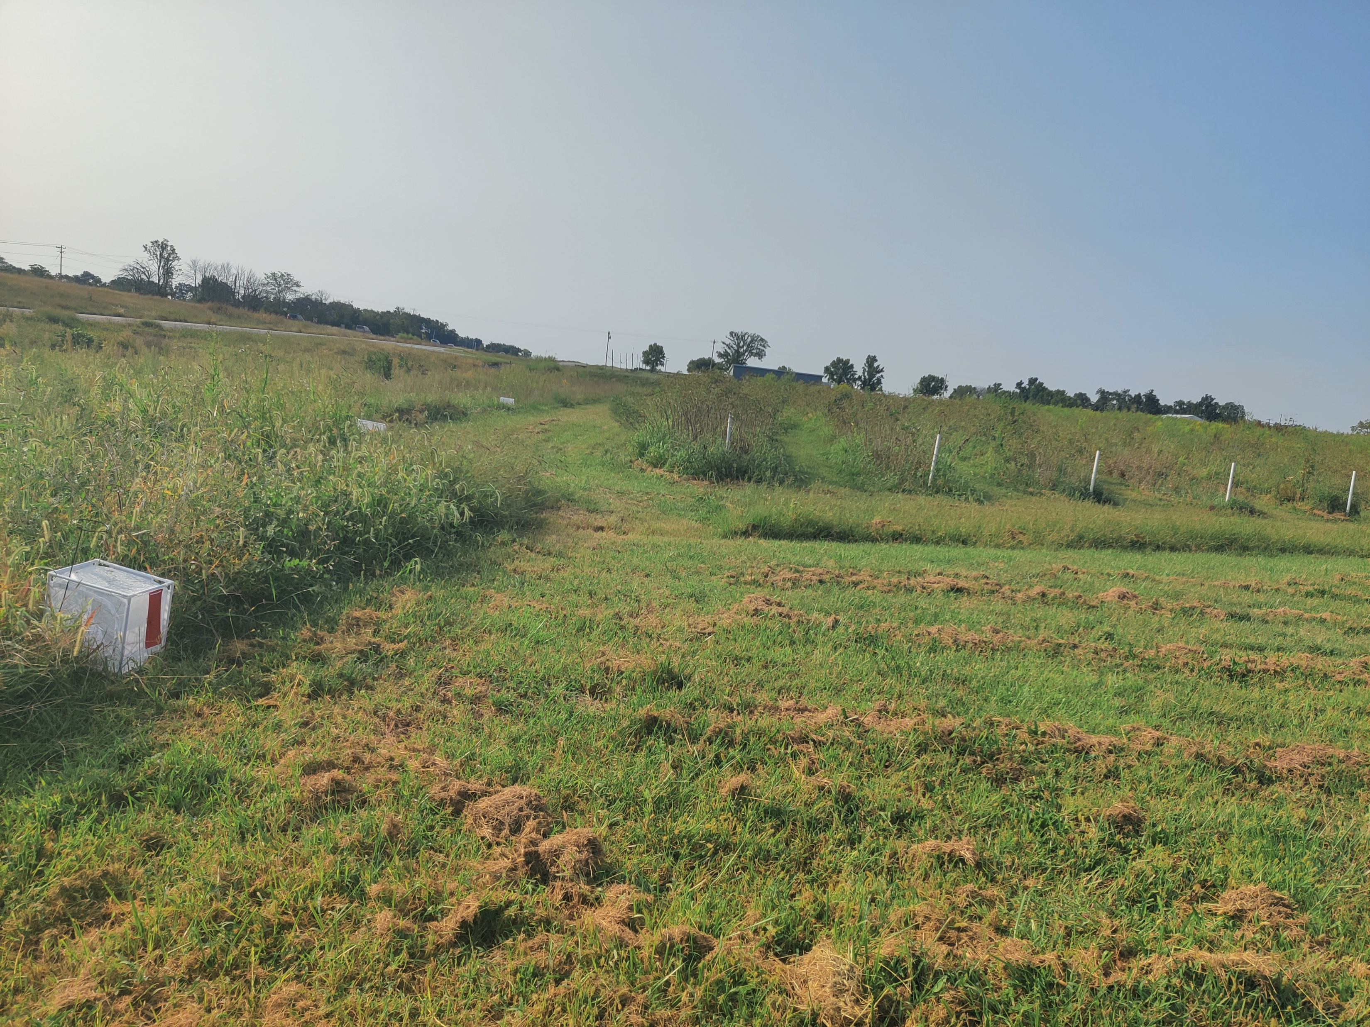
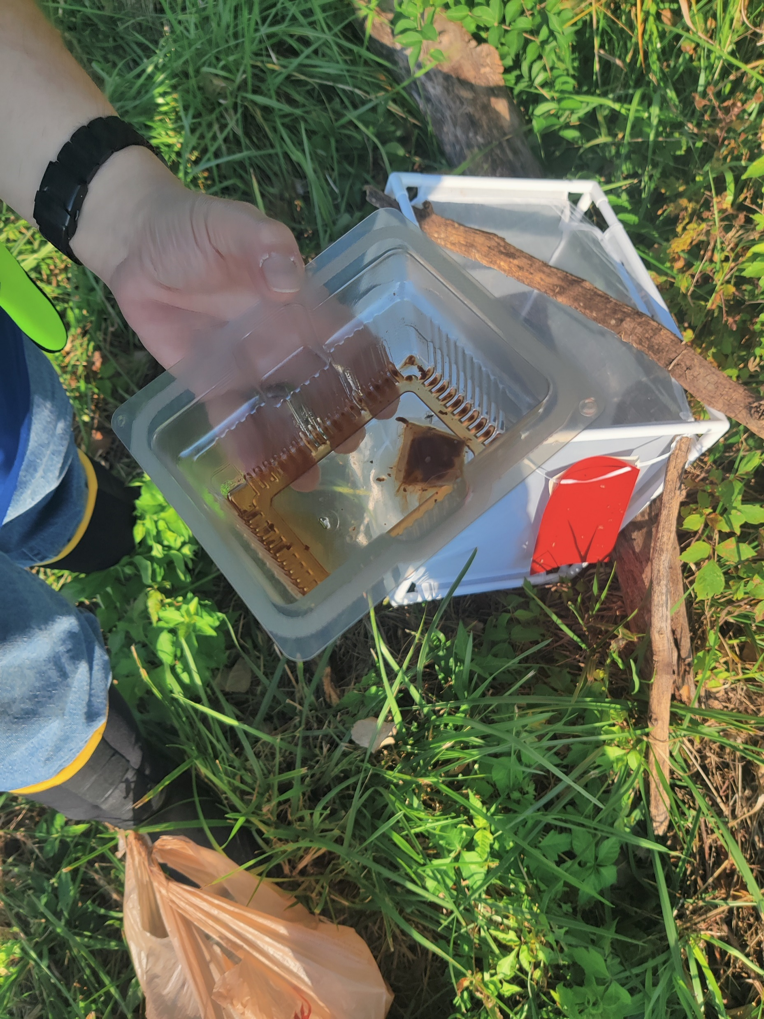
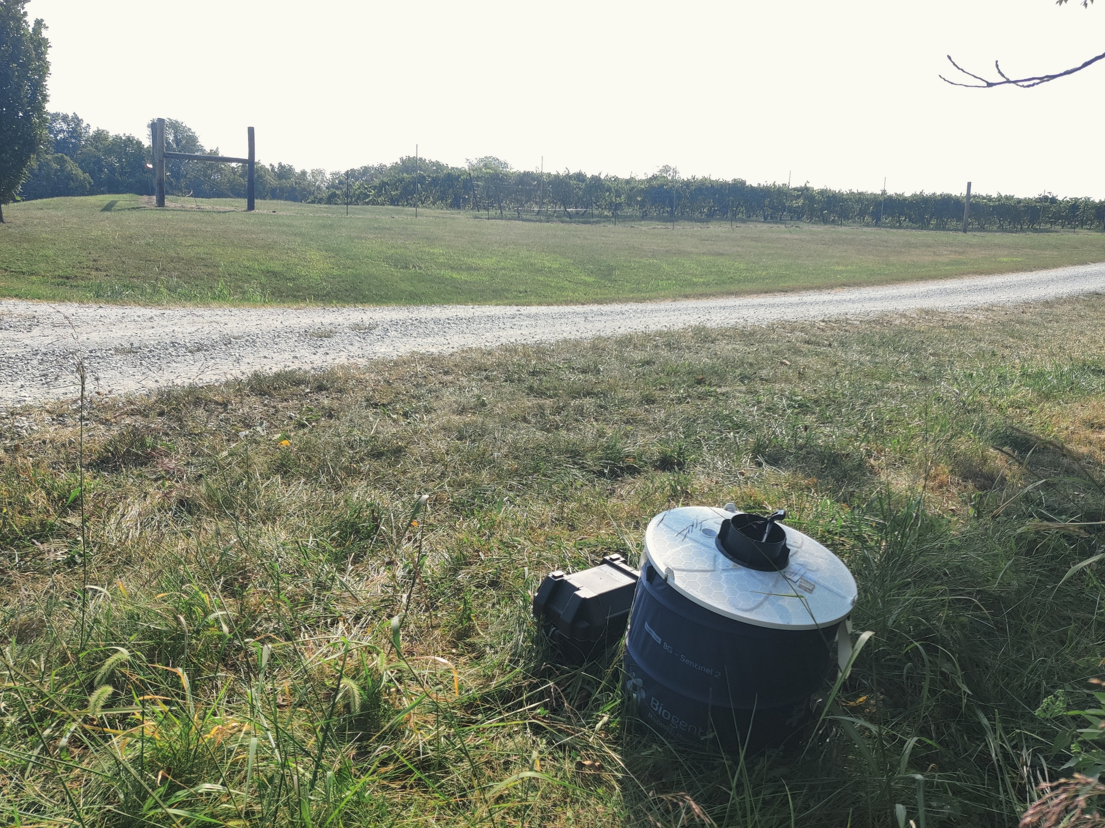
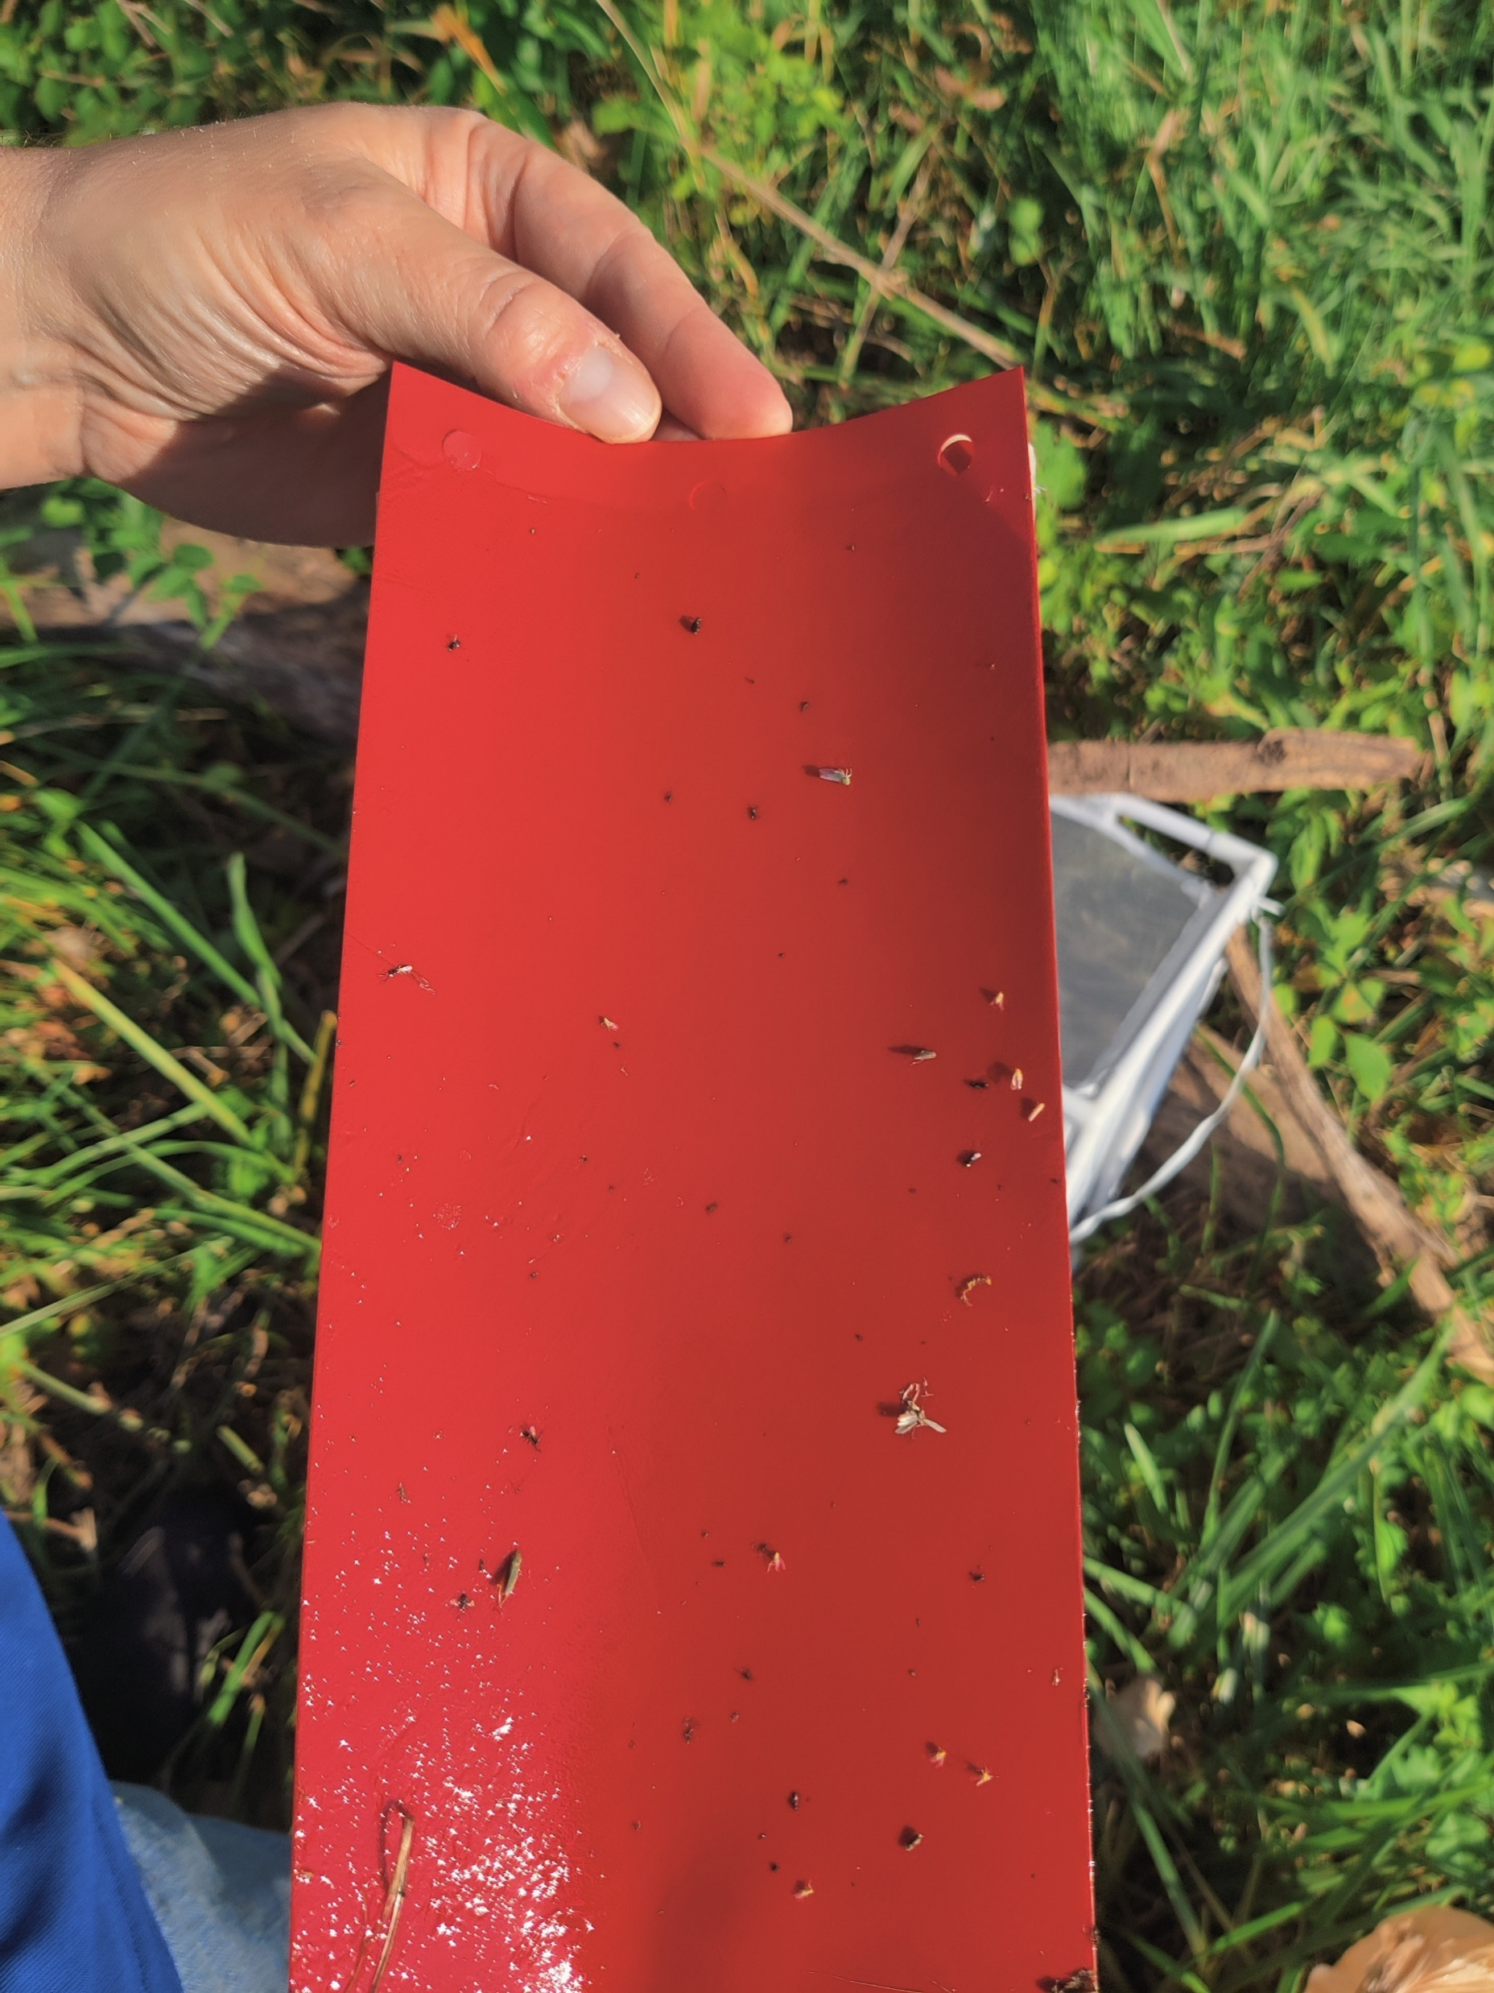
Field experiments (Sept-Oct 2024)
Tested lures
Water + yeast Coke + yeast Cherry juice Pherocon commercial SWD lure (Positive control) | 5) Coke + yeast + Pherocon lure 6) Water + Pherocon lure 7) Water + yeast + Pherocon lure 8) Water (Negative control)
Elderberry farm
Cages with lures 20 -30 meters from Elderberry plants
South Farm (grape)
Yeast porches in test lures
Rocheport: Les Bourgeois Vineyards (grape)
BG sentinel 2 Traps

Slide 7
Results: Effect of experimental factors on SWD trapping rates
Effects of study site, sex, week of collection and test lure on trapping rates (lure potential) of SWD
Factor | Df | SumsOfSqs | MeanSqs | F.Model | R2 | Pr(>F)
Sex | 1 | 0.122 | 0.122 | 1.738 | 0.028 | 0.174
site | 1 | 0.135 | 0.135 | 1.919 | 0.031 | 0.145
Test:Lure | 3 | 2.855 | 0.951 | 13.461 | 0.654 | 0.001***
week | 2 | 0.22 | 0.11 | 1.555 | 0.05 | 0.217
Sex:site | 1 | 0.075 | 0.075 | 1.072 | 0.017 | 0.365
Sex:Test lure | 3 | 0.163 | 0.054 | 0.769 | 0.037 | 0.601
Test lure:week | 1 | 0.009 | 0.009 | 0.138 | 0.002 | 0.904
Residuals | 11 | 0.777 | 0.07 | 0.178
Total | 23 | 4.361 | 1
Permutation analysis: ADONIS
SWD sex, study site and week of collection had no effect on trapping rates (P > 0.005)
Tested lures are the main determinants for SWD trapping rates (P < 0.005).

Slide 8
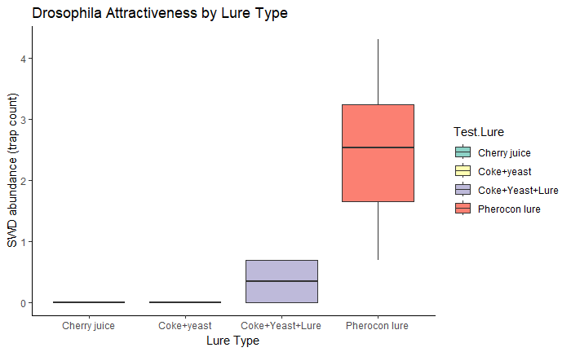
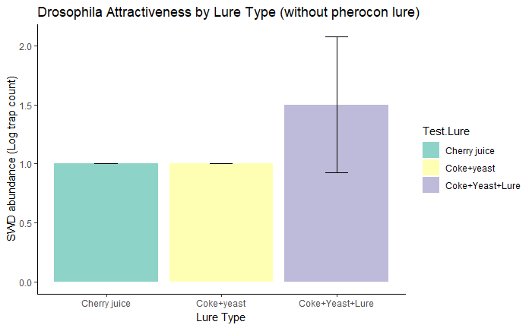
Results: Effect of test lures on SWD trapping rates
Treatments with no trapped SWD:
Water
Water + Yeast
Coke+yeast
Water+yeast+lure
Pherocon lure recorded highest SWD trapping rates compared to cherry juice (p = 0.011), coke +yeast (0.029), and coke +yeast + lure (p = 0.033).
No difference in attractiveness of sugar baits.
No effect of yeast on sugar baits.
Notes:
SWD more towards commercial pherocon lure since its more potent

Slide 9
Laboratory bioassay treatments
6 Treatments will be tested
Water
Water + Active yeast
Water + Inactive Yeast
Apple cider vinegar + Active yeast
Apple cider vinegar + Inactive Yeast
Apple cider vinegar
Our goal
Whether adding yeast increases attractiveness verse control (Negative-water and Positive-ACV)
Notes:
We decided to settle on a none attractant Appled Cider Vinegar (ACV) instead of reinventing the will
Will be tested because its on going work and this is the preliminary stage

Slide 10
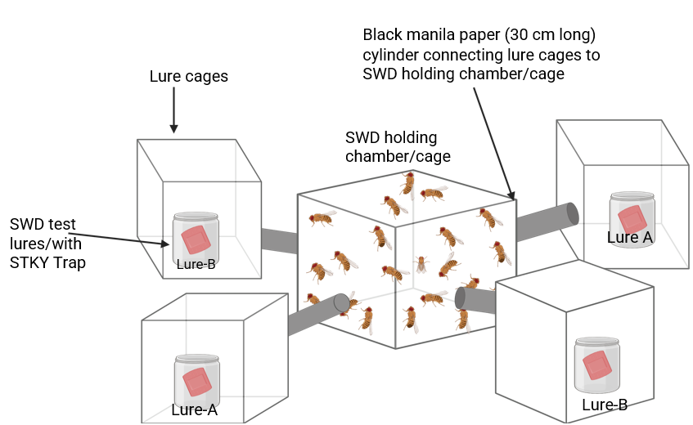
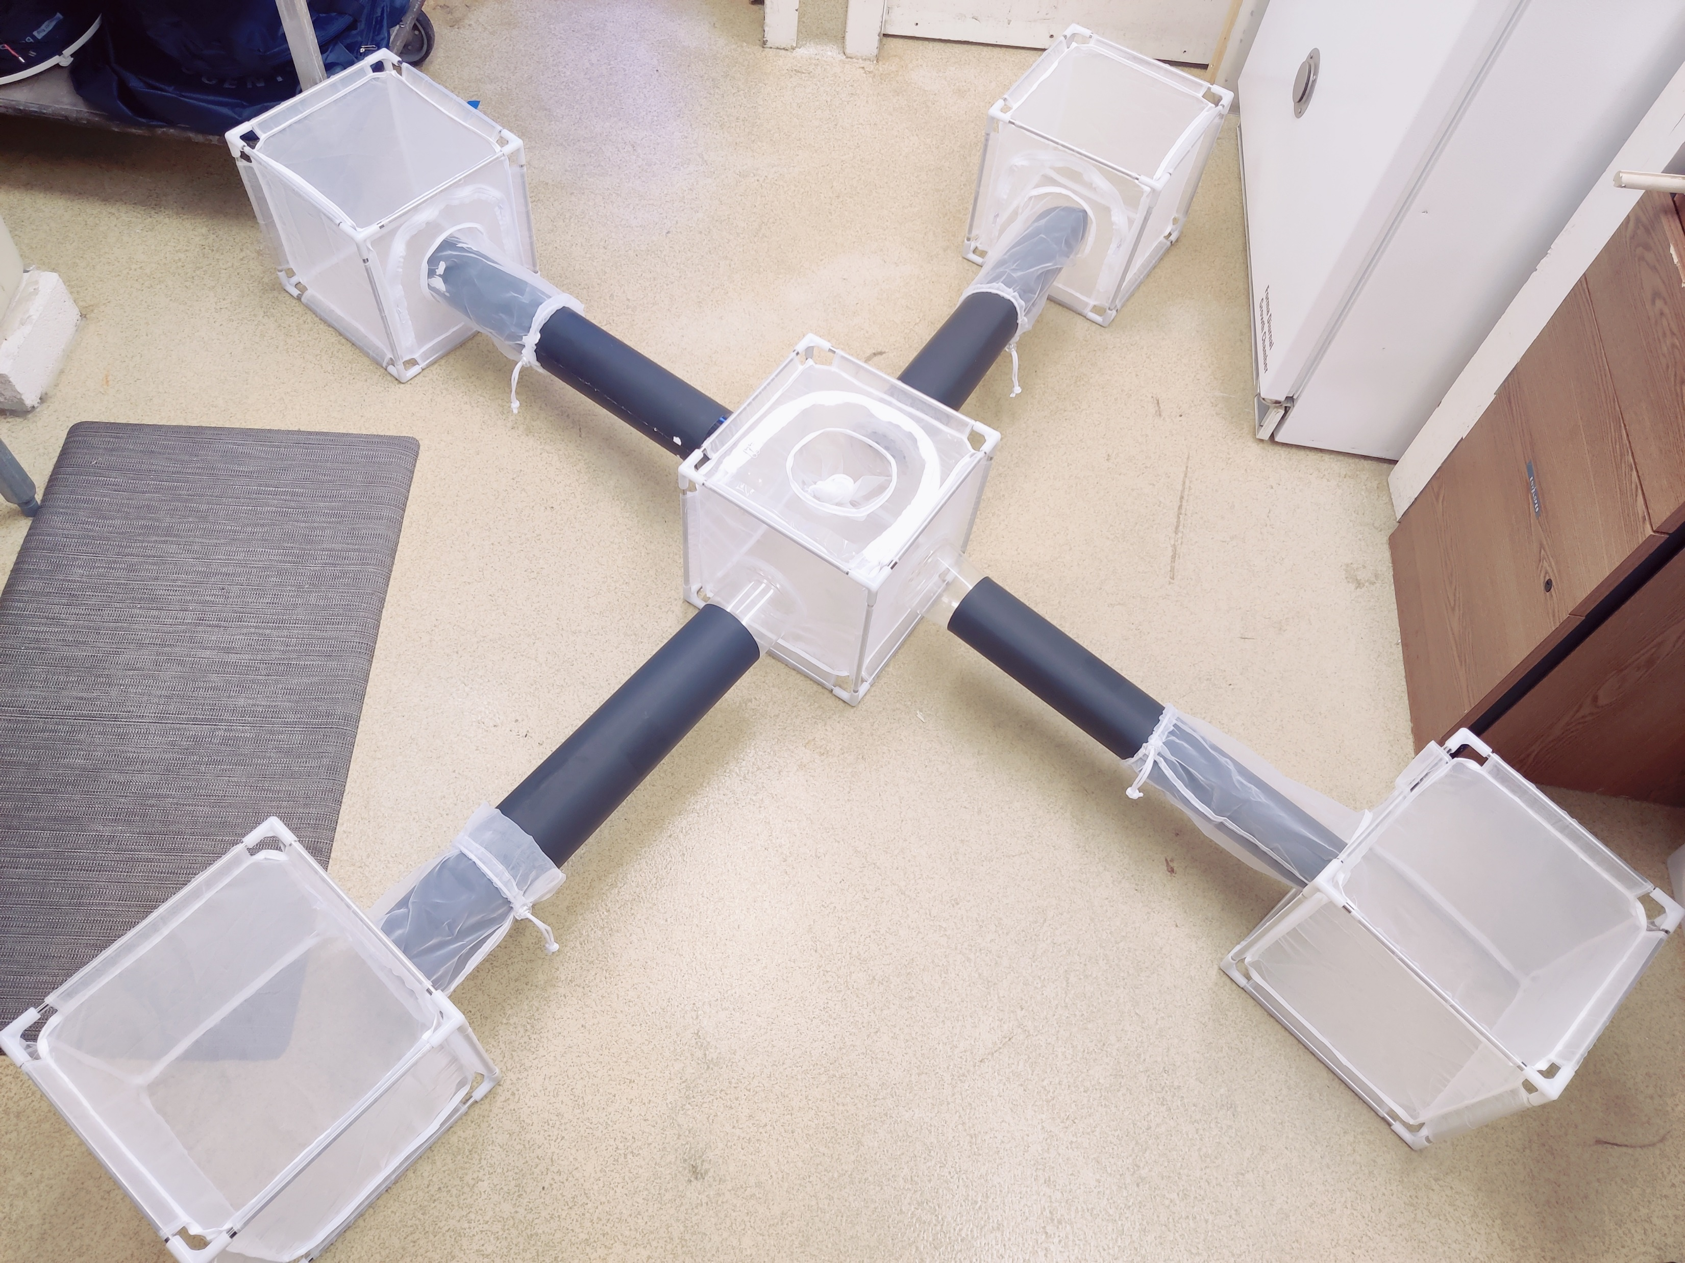
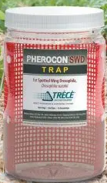
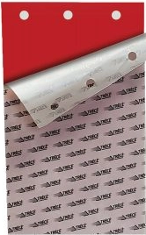
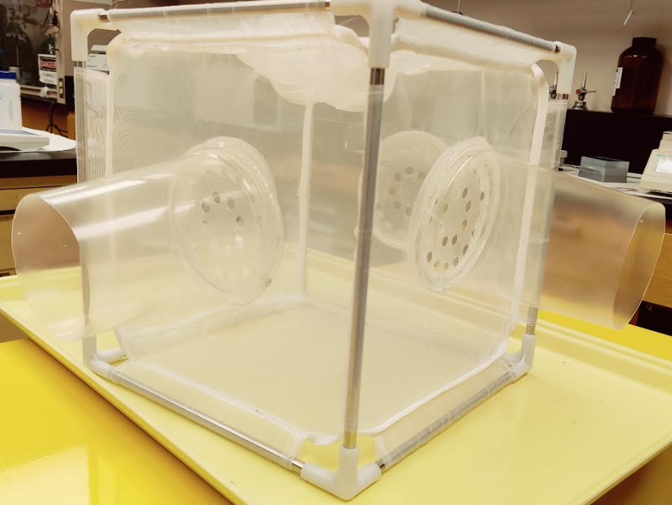
Bioassay using olfactometer prototype
60cm
Method
60cm
Release about 50 (F and M) SWD in central cage.
Observe after 24hrs
Count responding males and females SDW
Change sticky traps
Replace lures every 24hrs to maintain freshness.
4 replicates for each test
10cm
Central holding/release chamber (30cm× 30cm× 30cm)

Slide 11
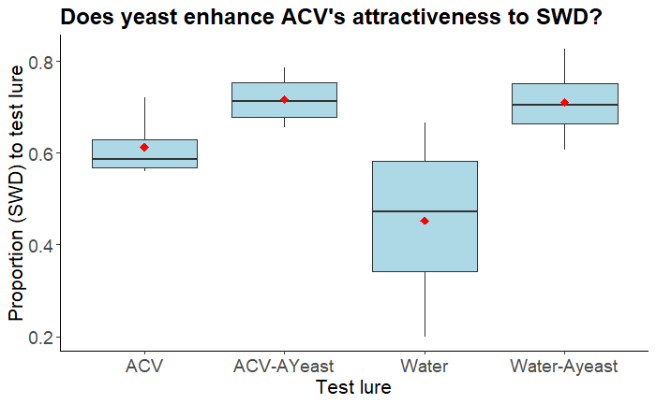
Effect of lure treatments on SWD response
Beta regression: logit link (n = 4 Reps)
betareg(formula = prop_treatment ~ Test_lure + Rep, data = protodata)
Parameters | Estimate | Std.Error | Z-value | P-value
(Intercept-”ACV”) | 0.1382 | 0.2585 | 0.535 | 0.5929
ACV-AYeast | 0.4867 | 0.2878 | 1.691 | 0.0909.
Water | -0.6618 | 0.2751 | -2.406 | 0.0161*
Water-Ayeast | 0.4403 | 0.2865 | 1.537 | 0.1243
RepRep2 | 0.3284 | 0.2809 | 1.169 | 0.2425
RepRep3 | 0.2749 | 0.2801 | 0.981 | 0.3264
RepRep4 | 0.6521 | 0.2878 | 2.266 | 0.0234*
Pairwise comparison: Emmeans (Adjusted-Bonferroni)
For Test response
Pairwise lure comparison |  |  | estimate | P-value
ACV | vs | (ACV-AYeast) | -0.10679 | 0.527
ACV | vs | Water | 0.16131 | 0.086
ACV | vs | (Water-Ayeast) | -0.09736 | 0.728
(ACV-AYeast) | vs | Water | 0.2681 | < 0.001
(ACV-AYeast) | vs | (Water-Ayeast) | 0.00942 | 1
Water | vs | (Water-Ayeast) | -0.25868 | < 0.001
No significant effect of Yeast on ACV attractiveness to SWD
Increase sample size/no of reps

Slide 12
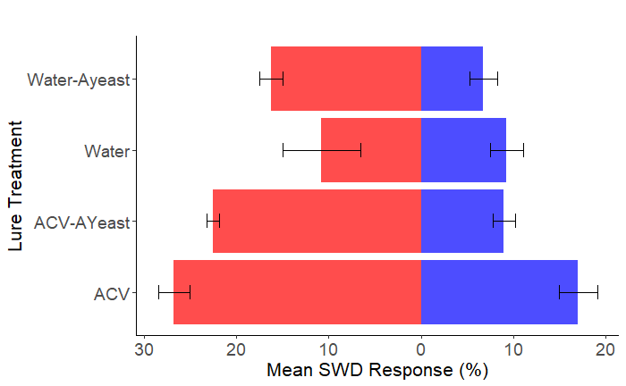
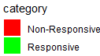
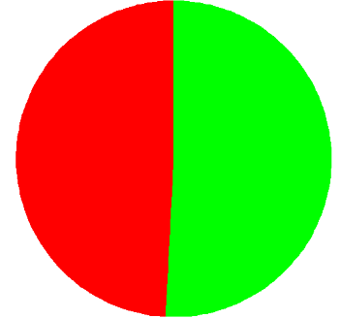
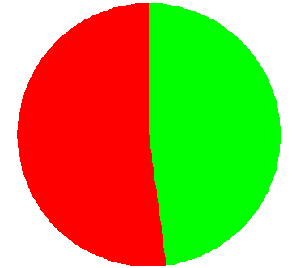
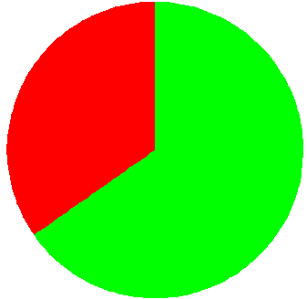
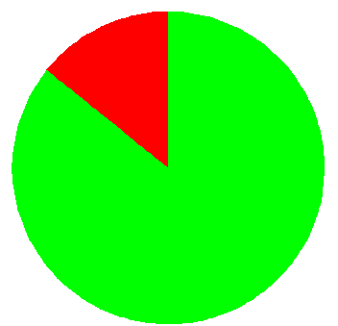
Effect of active-yeast (A-Yeast) on SWD attraction by ACV: Prototype
Test arm
(Lure)
Control arm
(water)
Non-response (%)
No of SWD tested (mean)
49.2%
50.8%
n = 181(45.2)
**
**
52.1%
47.9%
n = 167(41.7)
35%
65%
n = 193(48.4)
ns
ns
14%
86%
n = 204(51.0)
Notes:
Active yeast, has live yeast cells capable of fermentation.

Slide 13
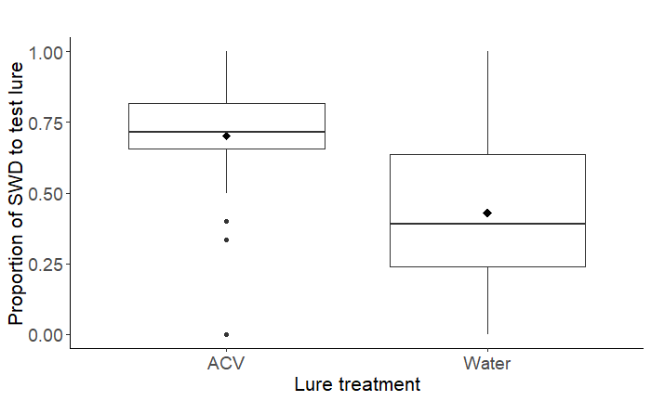
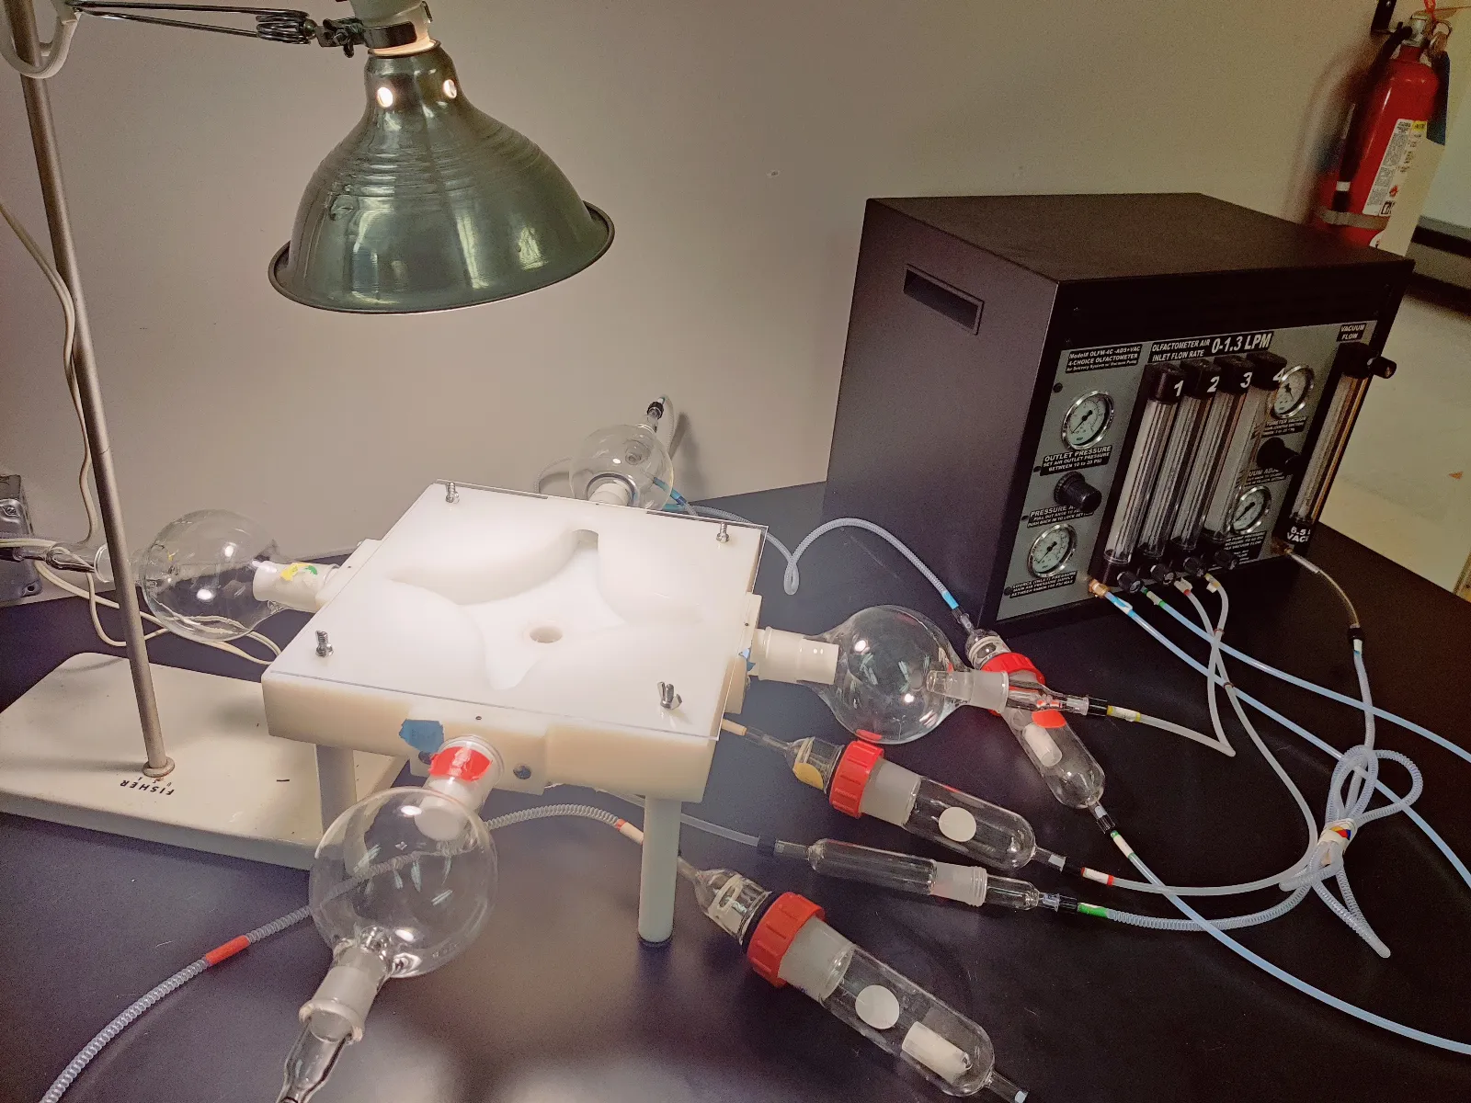
Four-way olfactometer
a
b
P < 0.01
1 SWD introduced in the insect release tube.
25 reps per lure
Two arms connected to test lure, other arm to control (water)
5 minutes for SWD to acclimatize
Response of SWD recorded after 10 mins.
SWD preferred ACV to water.
Challenge: Less than 20% of SWD responded to experimental treatments.
Credit to Dr. Emily Alhoff

Slide 14
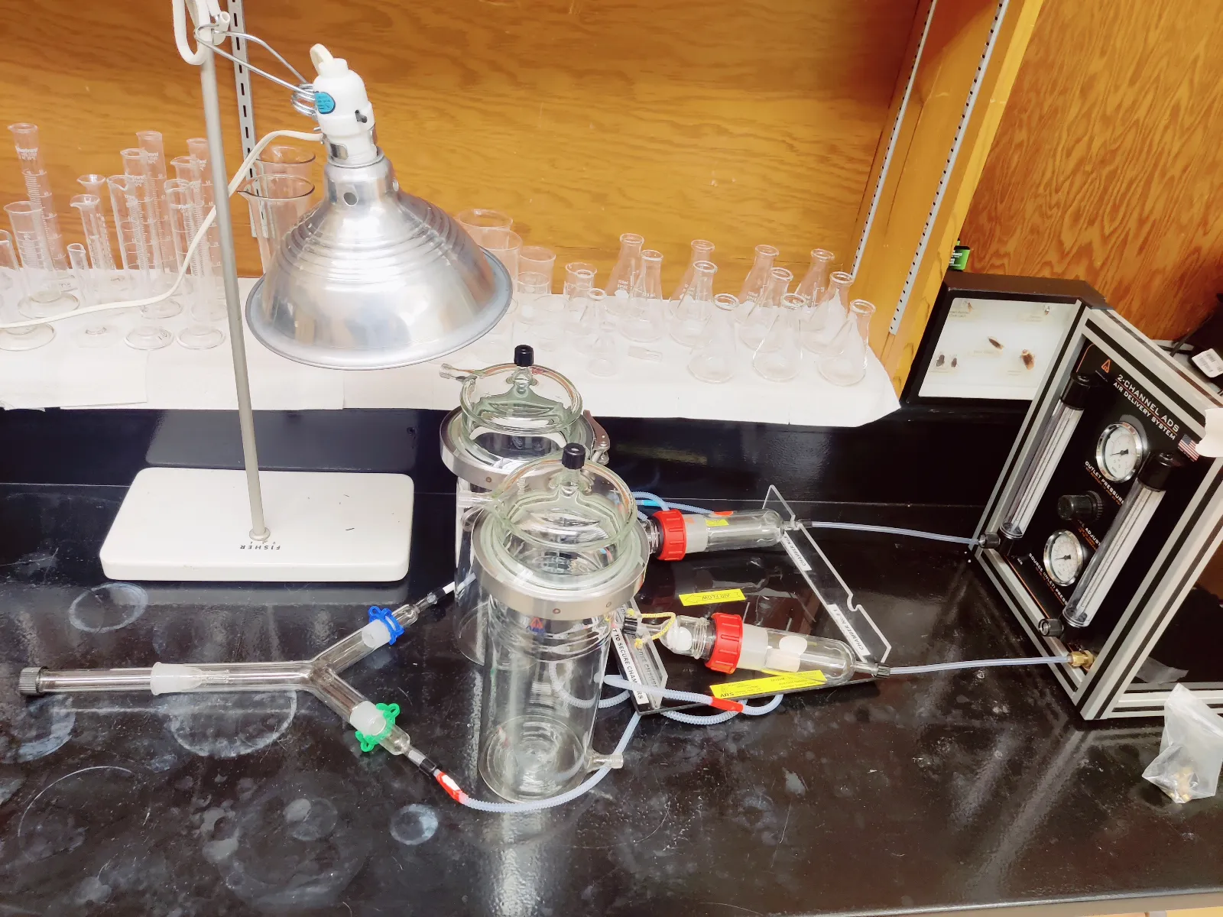
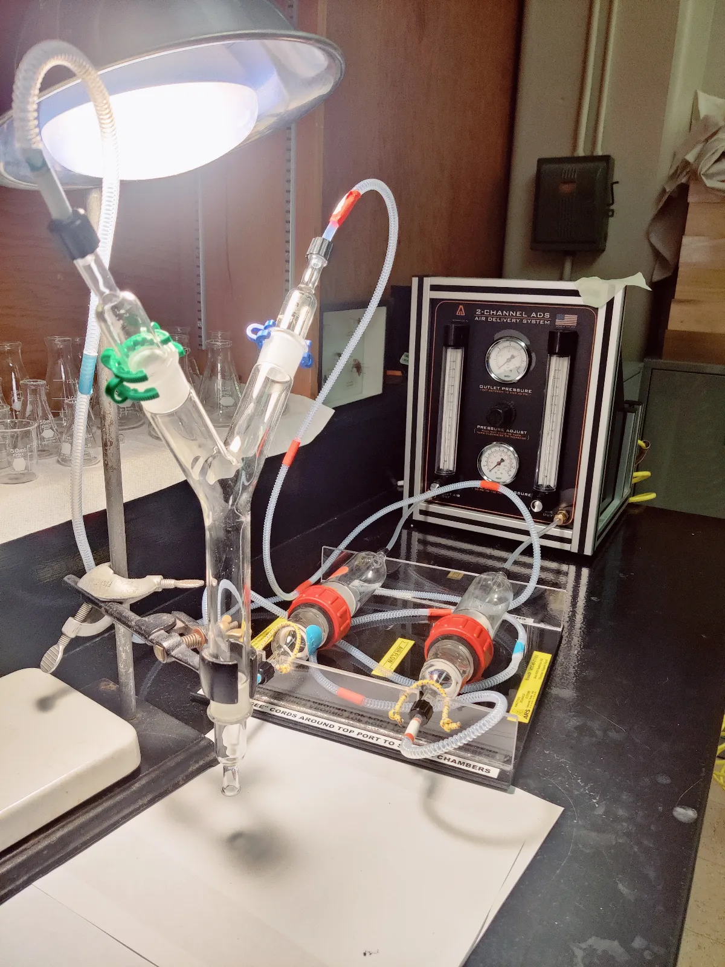
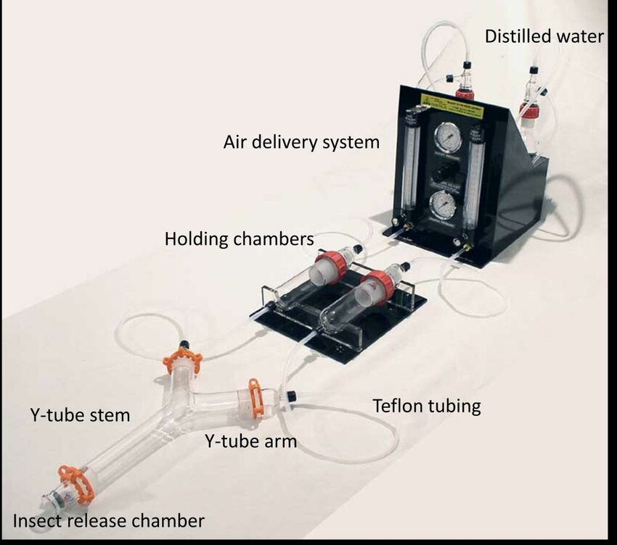
Two-way olfactometer (Y-tube)
5 to 13 SWD introduced in the insect release tube.
20 reps per lure
One arm connected to test lure, other arm to control (water)
5 minutes for SWD to acclimatize
Response of SWD recorded after 10 mins
Credit to Dr. Emily Alhoff
Parameters | Estimate | Std.Error | z value | Pr(>|z|)
(Intercept-ACV) | 0.7243 | 0.1476 | 4.907 | < 0.001***
ACV-Ayeast | -0.271 | 0.1741 | -1.557 | 0.119
ACV_Iyeast | -0.3776 | 0.1699 | -2.222 | 0.026*
Water | -0.7007 | 0.175 | -4.003 | 0.001***
Water-Ayeast | -0.2838 | 0.1724 | -1.646 | 0.099.
Water_Iyeast | -0.4791 | 0.1721 | -2.784 | 0.005**

Slide 15
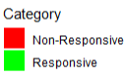
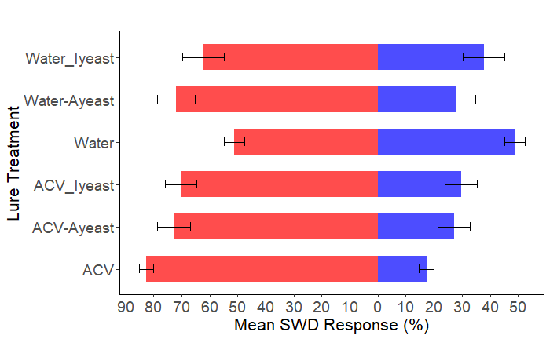
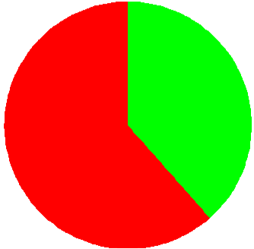
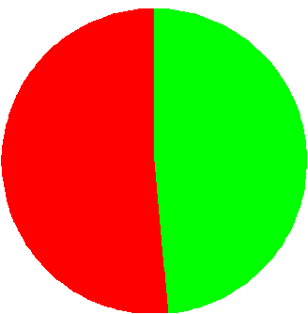
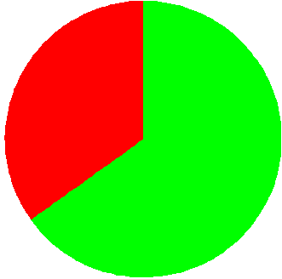
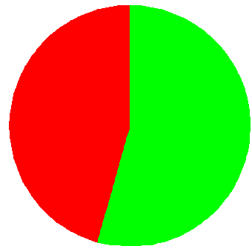
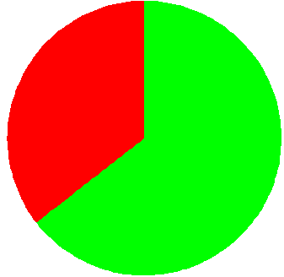
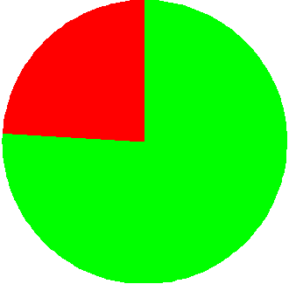
How does active and inactive yeast compare: Two-way olfactometer
Test arm
(lure)
Control arm
(water)
No of SWD tested (mean)
38%
n = 169 (8.1)
62%
51.5%
48.5%
n = 170 (8.2)
35%
n = 170 (8.55)
65%
45.6%
n = 171(8.50)
54.4%
n = 164 (8.50)
36%
64%
24%
n = 162 (8.45)
76%

